Slide 1

SOCIAL & EMOTIONAL LITERACY PROGRAMMES:
Zippy’s Friends and Apple’s Friends
Notes:
APF would like to share with you today a fantastic social / emotional literacy and mental health promotion programme designed to be delivered easily within the school curriculum or after care programmes. We are offering free training to those who are in a position to be able to deliver these programmes here in Cayman. Why do we need this? Social and emotional literacy are the foundation blocks of lifelong mental wellbeing. The mission of APF is to improve the mental health of children and young adults in the Cayman Islands through advocacy, awareness and support.
So let me introduce the PfC programmes…

Slide 2

Notes:
Partnership for Children is the NGO which produces the Zippy's Friends and Apple's Friends programmes. It’s based in the UK, but it could be anywhere in the world. Working with partner agencies all around the world means they can reach thousands of children – like the small hub of a big wheel.
The Partnership for Children motto is ‘Good mental health for children – for life’, and this obviously has a double meaning: teaching children the skills they will use in their lives now, and that these skills will last for the rest of their lives.

Slide 3
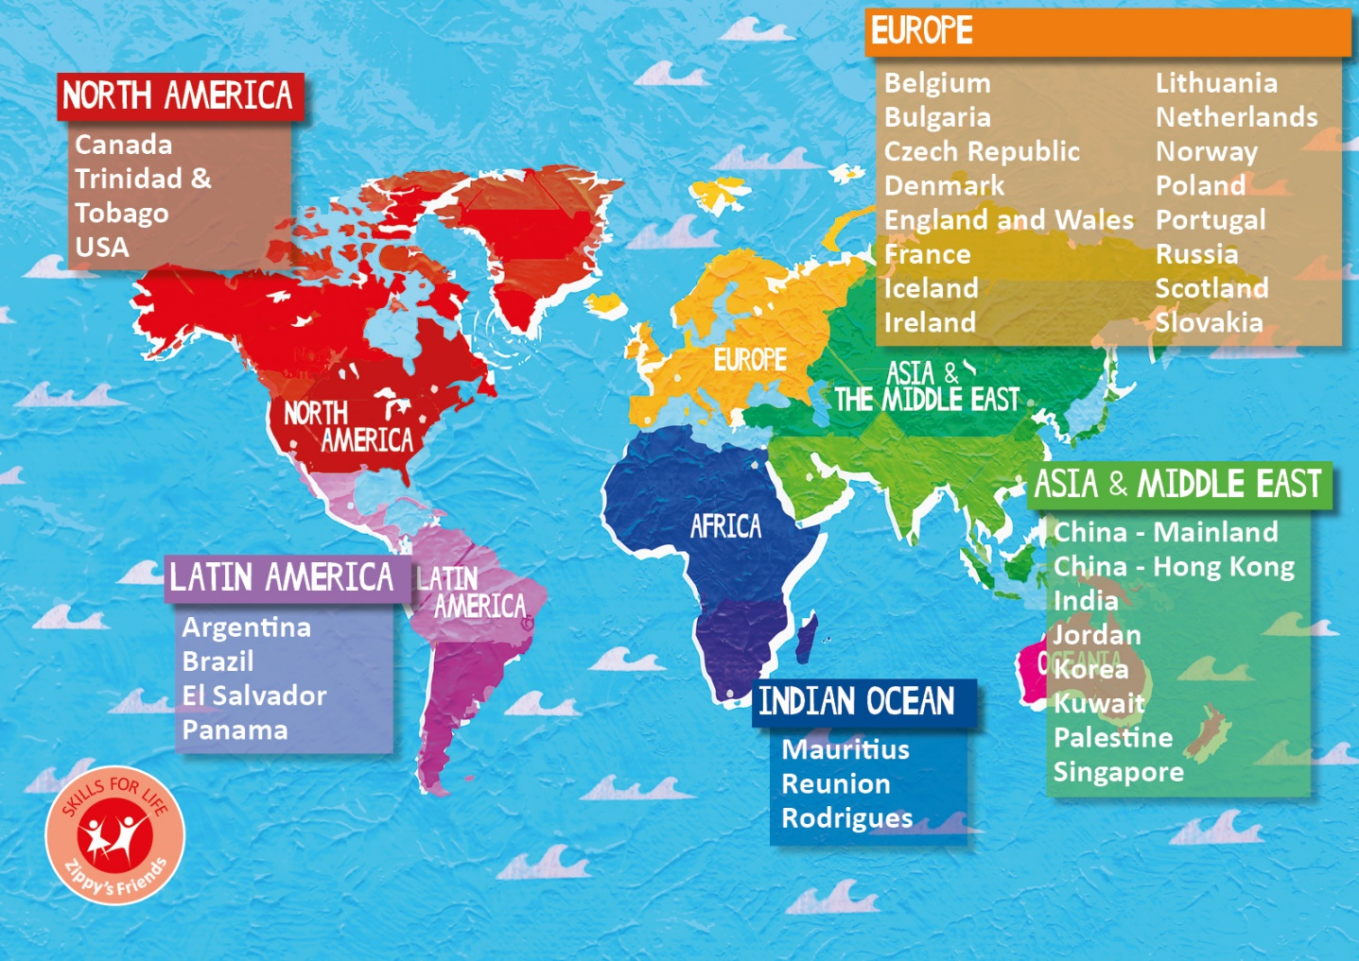

Zippy and Apple around the world
Notes:
PfC works in partnership with 30 countries around the world, their latest partner is Palestine and to date has reached over 1.8million children.
The partners come in all shapes and sizes, from tiny NGOs to big government departments.

Slide 4

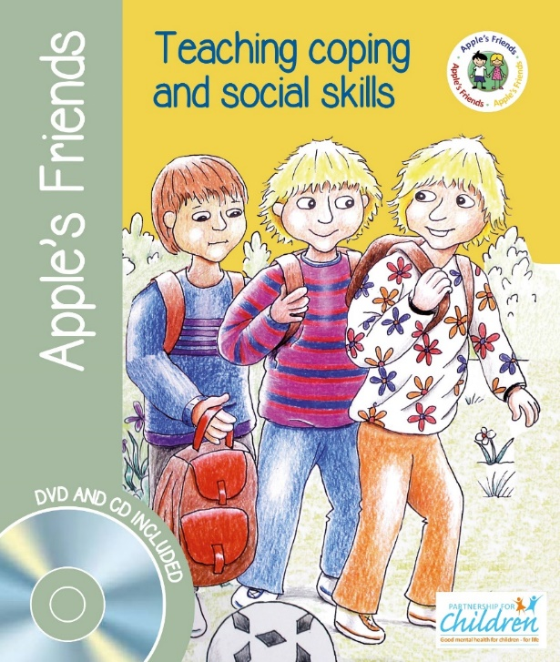
Zippy’s Friends and Apple’s Friends
Evidence-based programmes that promote children’s coping and social skills
Zippy’s Friends: 5 – 7 year - olds, Apple’s Friends: 7 – 9 year-olds
Notes:
How were Partnership for Children’s programmes produced?
PfC was formed in 2001 after Befrienders International, a global suicide prevention agency with telephone hotline services in 41 countries had the opportunity to develop a new programme for young children. They decided to develop a programme to give children the skills to cope with difficult situations and be better equipped to deal with crises and difficulties as teenagers and adults. Now called Zippy’s Friends, it was a school-based programme to teach six and seven year olds healthy coping and social skills.
Zippy’s Friends usually runs with 5-7 year old and the follow on programme, Apple’s Friends for 7-9 year olds was produced in 2016.
The programmes are story based and follow a group of children and their pet stick insect Zippy or hamster Apple as they deal with common situations to children of that age. Each session there is a story with activities related to the characters.

Slide 6
Zippy’s Friends and Apple’s Friends:
Mental health promotion programmes
Whole class programmes
International programmes
Evidence-based programmes
Story-based programmes
Notes:
Mental health promotion programmes = designed to develop the coping skills and promote the mental health of all children. The programme is not a treatment programme for poor mental health or a targeted prevention programme for particular children. We believe all children need to be the taught emotional and social skills.
Whole class = Designed to be implemented to the whole class so children can learn from and support each other
International = running in over 30 countries around the world - no matter the country, all children have the same worries and concerns about friendships, coping with change, bullying etc.
Story based = every session involves a story and the activities are related to the characters in the story

Slide 7
Story-based, with six modules:
Feelings
Communication
Making and breaking relationships
Conflict resolution
Dealing with change and loss
We cope
I like the characters – they’re just like me
The programme is taught over 24 weeks with four sessions per module. Each session lasts about 40 minutes.
Notes:
Just to give you a brief overview of the contents of the programme for Zippy (which is similar for Apple):
We start with feelings and helping children to recognise them- focusing on happy, sad, angry/annoyed, jealous and nervous. After learning to identify feelings, we move on to communicating them to others.
Module 2 also looks at asking for help – a very important coping strategy.
Module 3 focuses on friendship - what makes a good friend, how we make and keep friends, and then Module 4 looks at when friendship goes wrong - dealing with conflict and bullying.
In Module 5 we look at change and loss. Young children have to deal with a lot of changes, many of which are outside their control, such as moving schools or parents splitting up. Module 5 looks at coping strategies for dealing with change. Spoiler alert! In the story in Module 5, Zippy dies, and we look at how the children and others cope with this.
Module 6 brings everything together, reinforcing the learning from Modules 1-5, and ends with a party and celebration at the end.

Slide 8
Notes:
1.54 – 3.06
https://www.partnershipforchildren.org.uk/our-impact/videos.html

Slide 9
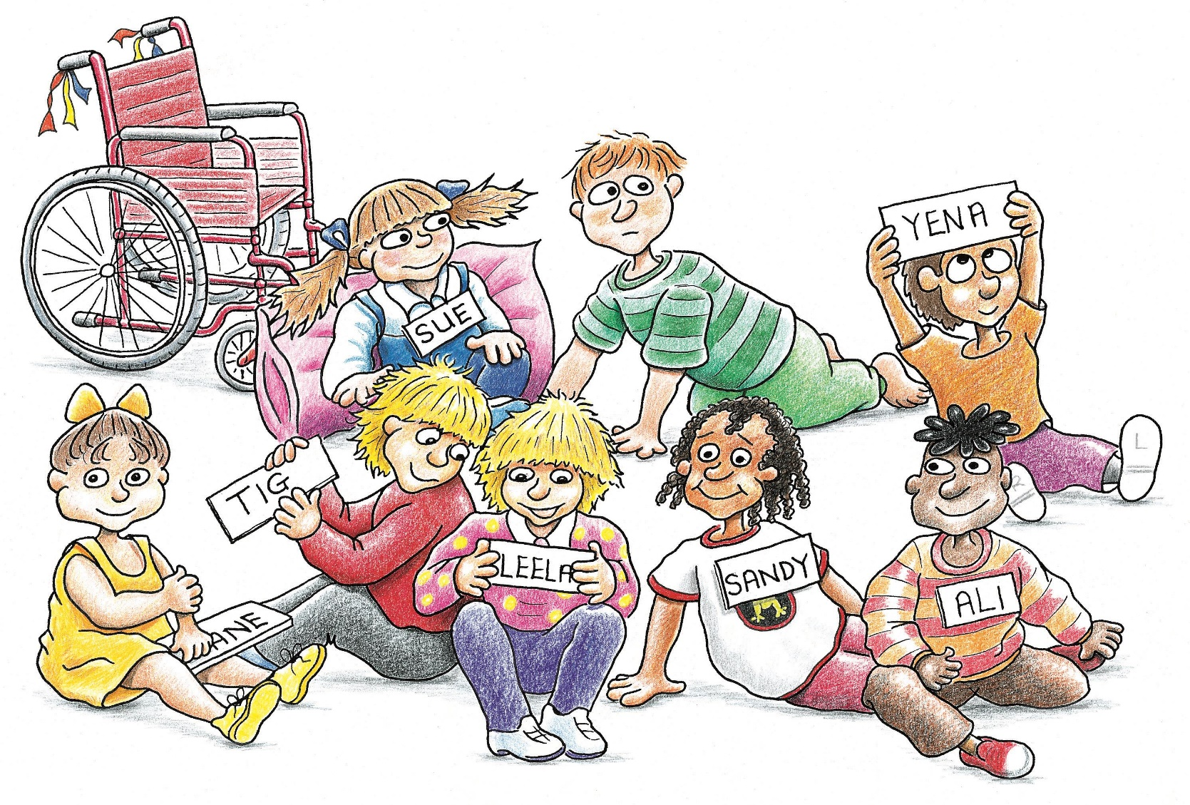
Zippy’s Characters

Slide 10
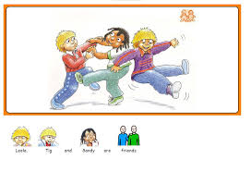
Module 1: Feelings
Goal: To improve children’s abilities to recognise difficult feelings and to identify coping strategies to deal with those feelings
    Session 1: Feeling sad – feeling happy
    Session 2: Feeling angry or annoyed
    Session 3: Feeling jealous
    Session 4: Feeling nervous

Slide 11
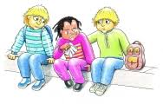
Module 2: Communication
Goal: To improve children’s abilities to communicate their feelings
    Session 1: Improving communication
    Session 2:Listening
    Session 3:Who can help us?
    Session 4:Saying what you want to say

Slide 12
Module 3: Making and Breaking Relationships
Goal: To improve children’s abilities to make friends and to cope with rejection and loneliness
    Session 1: How to keep a friend
    Session 2:Dealing with loneliness and rejection
    Session 3:How to resolve conflicts with friends

Slide 13
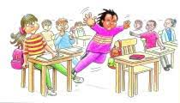
Module 4: Conflict Resolution
Goal: To improve children’s abilities to resolve conflicts
    Session 1: How to recognise good solutions
    Session 2:Bullying
    Session 3:Solving problems Session
    4:Helping others to resolve conflicts

Slide 14
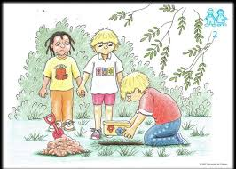
Module 5: Dealing with Change and Loss
Goal: To improve children’s abilities to cope with change and loss
    Session 1: Change and loss are part of life
    Session 2:Coping with death
    Session 3:Visit to a graveyard
    Session 4:Learning from change and loss

Slide 15
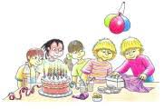
Module 6: We Cope
Goal: To improve children’s abilities to use a variety of coping strategies
    Session 1: Different ways to cope
    Session 2:How to help others
    Session 3:Adapting to new situations
    Session 4:Celebrating together

Slide 16
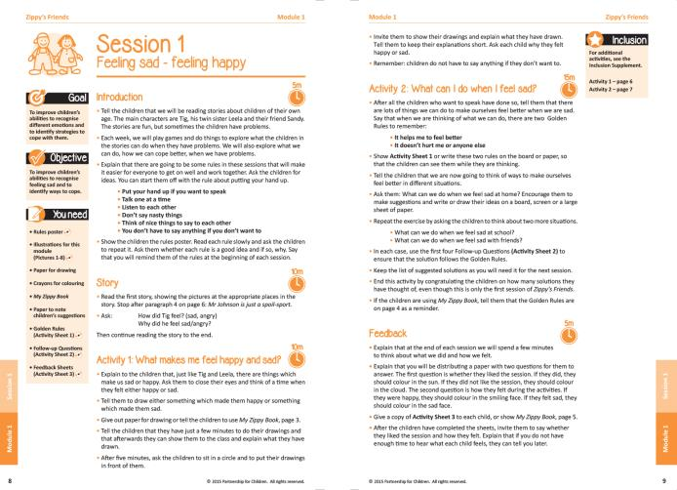
Notes:
Each module has 4 lessons, based around a story, and each session has a detailed lesson plan.
There is a similar format for each lesson:
The rules
Introduction/recap
Read the story/part of the story
Activities
Feedback
Training for Teachers (Full Day)

Slide 17
Activities
Notes:
Example activity 5.07-5.42
Show 7.05 – 8.03
https://www.partnershipforchildren.org.uk/our-impact/videos.html

Slide 18
Activities

Slide 19


What is coping?
Coping strategies should...
improve the situation or make us feel better - or both
not harm you or anyone else
Notes:
The programme teaches children coping skills through the Zippy and Apple golden rules
How to choose a good solution:
It makes me feel better
It doesn’t hurt me or anyone else
Any solution that obeys these rules is a good solution. In this way, even young children can learn how to identify and assess helpful coping strategies. The programme does not teach right and wrong strategies, but rather helps children find their own solutions.
Training for Teachers (Full Day)

Slide 20
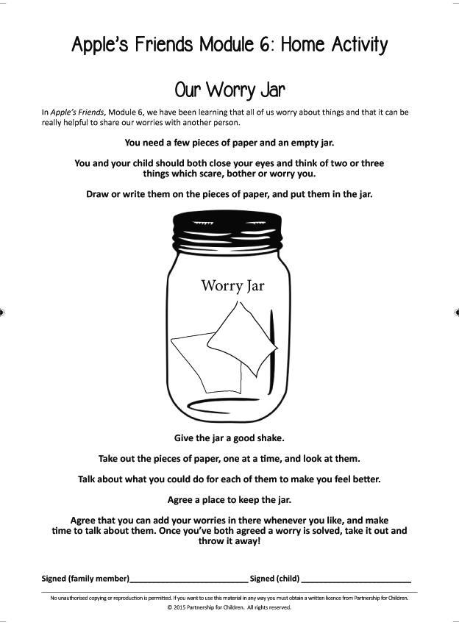
Home Activities
One per module
To be completed at home with a
family member
Notes:
Both programmes have one activity sheet to send home at the end of each module.

Slide 21

Notes:
There is also an adaptation of Zippy's Friends for pupils in special schools or specialist resource provisions.
This was developed initially with Professor Barry Carpenter, expert in ID and mental health in education and with Sunfield special school in the UK – the main changes to the programme were the addition of Widgit Symbols and shortened stories, as well as extra visuals and sensory based activities to make the programme more accessible. For every 1 activity in the mainstream programme, an alternative 4-6 activities were created for the SEN supplement so teachers can choose the one most suitable to their pupils.
This programme works best for children aged 7-11 with SEND but has also been used up to the age of 19.

Slide 22
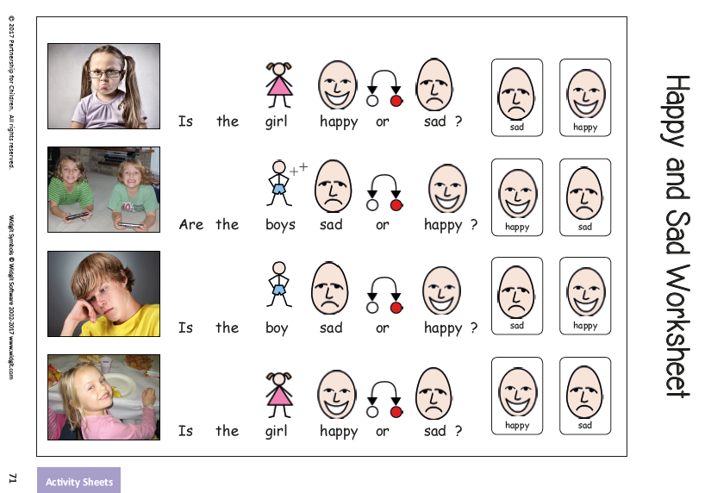

Slide 23
SEND
Notes:
Let’s see it in action - Teaching example for SEND programme
2.37 – 3.55
https://youtu.be/RU2nvn0rwPo

Slide 24
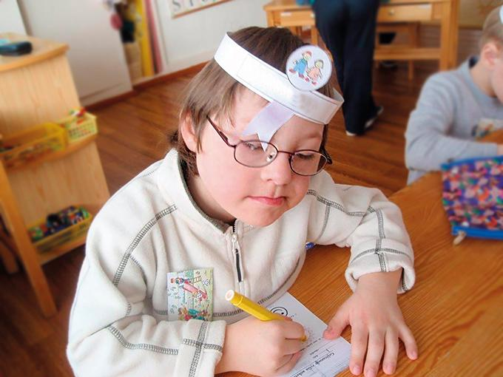

ZF for SEND Evaluation
Teacher ratings:
Significant improvements in:
  Communication
  Cooperation
  Managing emotions
  Relationship skills
  Self-awareness
Parents reported:
  Behavioural
  improvements
  Improved mood
Notes:
A recent evaluation was done by The University of Birmingham, UK, on the first half of the SEN adapted programme. It was completely independent and funded by another organisation. All PfC provided was the resources and training.
looked at children before and after completing Modules 1-3
took place in 2014-2015 with 8 special schools and 53 children
collected data from teachers parents and children before and after the programme
Here are some of the results
Teachers indicated that the children’s social skills, emotional literacy, and emotional recognition improved after taking part in Zippy. Significant improvements were observed in communication, cooperation and self-awareness based on emotional literacy assessments and social skills scales.
Parents reported improved behaviour and mood at home.

Slide 25
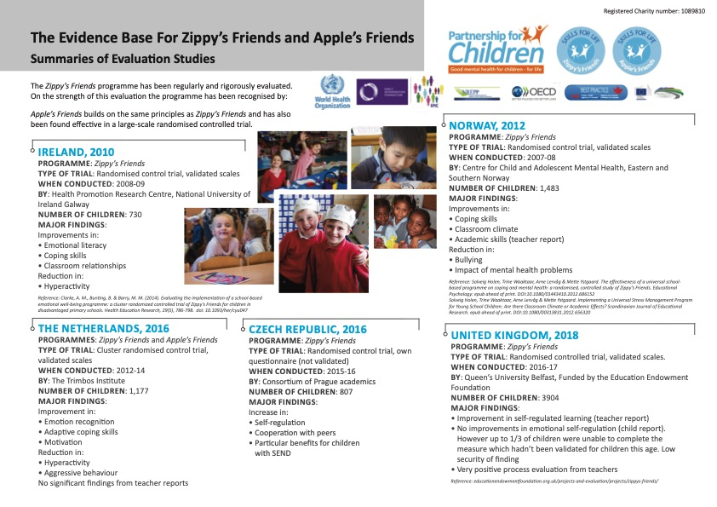
Notes:
Summary of the evaluation studies on the screen showing the evidence base for Zippy’s Friends and Apple’s Friends
Independent research from international universities
Five randomised controlled trials (RCTs)
Over 8000 children
Results show the programme is equally effective for boys and girls, clear improvement in social skills and ability to cope with difficulties, KG kids who took part in the programme handled the transition to primary school more successfully than those who did not take part

Slide 26

International Recognition
Notes:
The programmes have received international recognition from the organisations above.

Slide 27
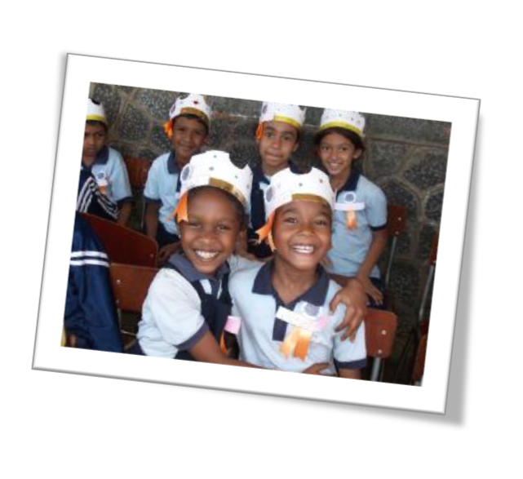
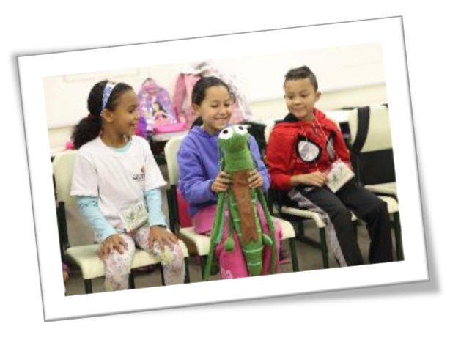
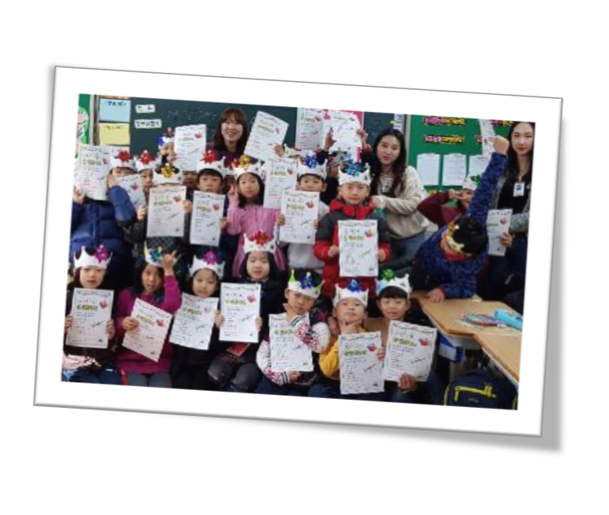
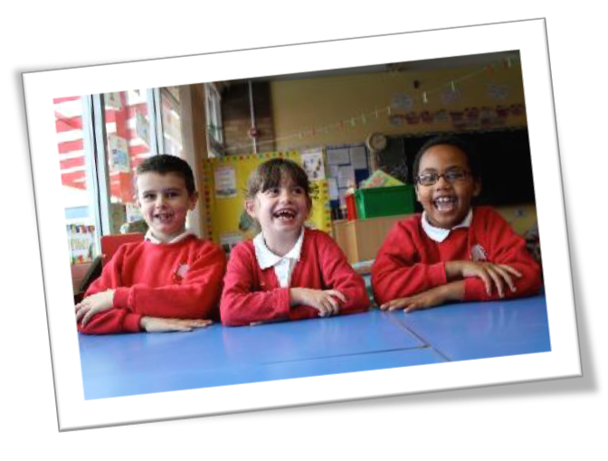
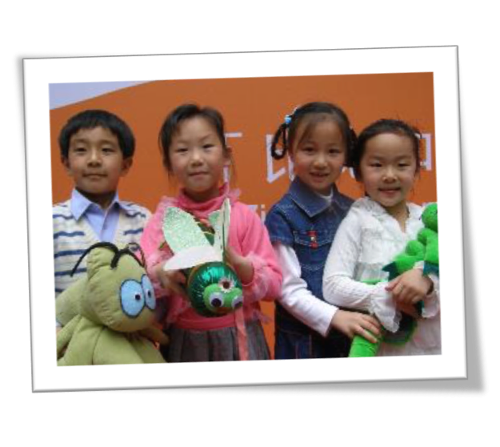
Notes:
Photos of children taking part across the world

Slide 28
What teachers say
It has helped with behaviour issues and the children managing their own behaviour in the classroom and playground.
One child has lost her mother in the last year and this course has enabled her to deal with many of her thoughts and emotions. This has been backed up by conversations with her father.
The children love Zippy and his friends and always ask when I am coming to do Zippy again!
Notes:
Some quotes from teachers – hear more on the videos at PfC website

Slide 29
What parents say
There’s one of the cards that she got from school, you know, how to deal with a problem that you don’t know how to resolve… she still got that stuck on her wall in her bedroom
Apple’s Friends helped my son a lot. Now he communicates much more openly and makes friends easily. The program taught him to adapt to life and other children in the classroom. He became more flexible and learned to solve or even to avoid conflicts.
Notes:
And here are some quotes from parents.
A parents guide to the programme is provided to all families

Slide 30
What children say
Now I know that there are many ways to get out of bad situations. I never knew there were so many names for emotions.
I like the characters – they’re just like me
I felt better when I learned that others sometimes feel like I do.
It’s taught me ‘how’ to be kind to other people
Notes:
And importantly the children themselves really enjoy the programme and can see how much it’s helped them

Slide 31
Zippy and Apple in Cayman
Contractual agreement with schools
Impact Assessment
2-day training
Five master trainers
Ongoing support for teachers

Slide 32
Partnership
  Time for training & teacher support
  Allocation of time for program delivery
  Delivery only by specially trained teachers
  Support of program ethos across school
  Trained teachers to hold parent information sessions
  Protect the intellectual property of the programmes
  PfC support visits
  Assessment of effectiveness of programmes
Notes:
Principals will support the ethos of the programmes throughout the school
Principals will enable specially trained teachers to hold information session(s) for parents about the programmes
Principals will sign a copyright agreement to protect the intellectual property of the programmes
Principals will allow representatives of the Alex Panton Foundation and Partnership for Children to visit and observe classes taking part in the programmes
Principals will allow for assessment of effectiveness of programme(s).

Slide 33
Contact details
Dr. Xenia Sotiriou – Goddard
Project Lead
Dr. Catherine Day
SEND Lead
zippy@alexpantonfoundation.ky
https://alexpantonfoundation.ky/
Email: info@alexpantonfoundation.ky
https://www.partnershipforchildren.org.uk/
Notes:
More information on PfC website, including case studies and videos.

